Slide 1
磨料射流切缝形貌3D表征方法
答辩人：姬李丹阳
导师：张仕进
2021.05.08

Slide 2
研究概述
目 录
CONTENTS
研究内容
结论
总结与展望

Slide 3
研究概述
01
内容概述、研究背景、文献综述

Slide 4
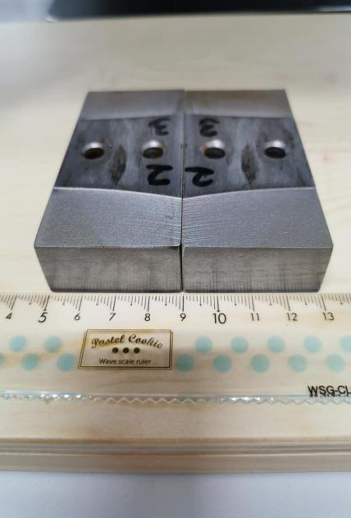
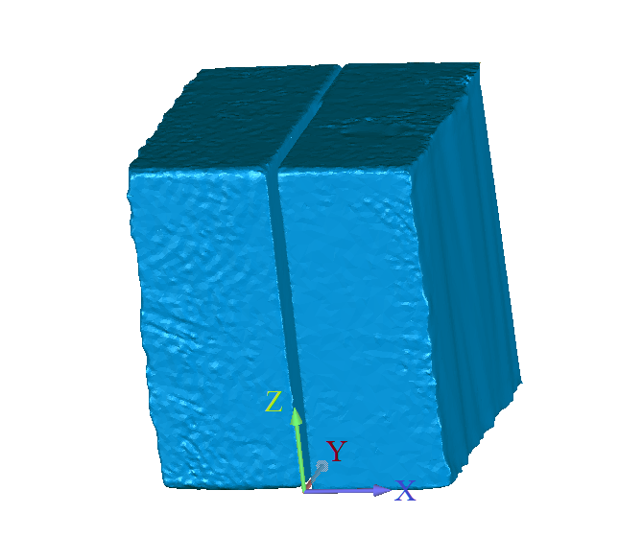
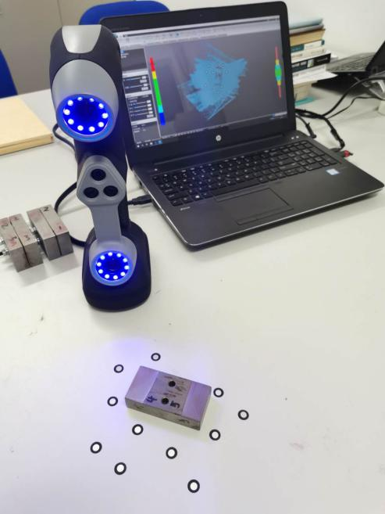
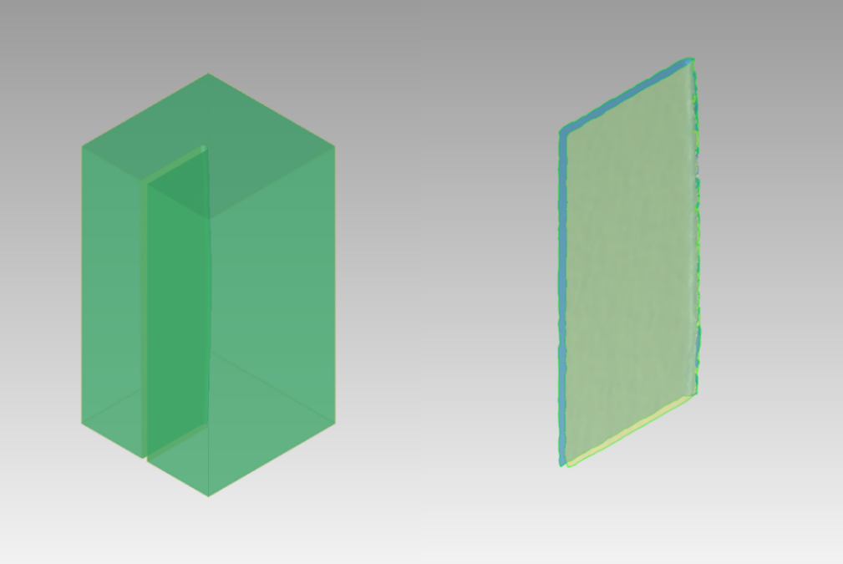
内容概述
1
2
本文主要针对磨料水射流切割技术，基于“能量和理论”，运用无损获得切缝形貌的方法、采集切缝形貌的方法以及切割仿真的方法，研究如何表征磨料射流切缝形貌的问题与如何改善磨料射流切割质量的问题。
4
3

Slide 5
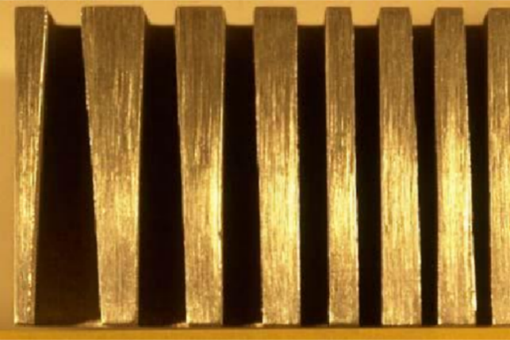
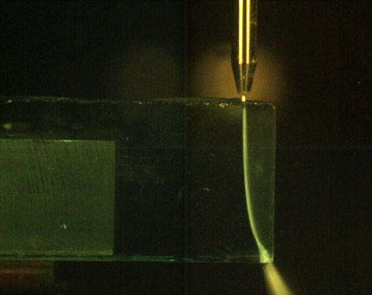
研究背景
1
随着磨料射流技术的发展，磨料射流始终存在加工误差的问题愈发引起业界和学界的重视。考虑到现有研究在加工零件的局部区域特别是相对较厚的零件时，精准预测和补偿其加工误差上的不足，本文重点聚焦于磨料射流切缝形貌的表征、射流流形的描述、仿真补偿的问题。
2

Slide 6
文献综述
现有研究从磨料射流切缝的局部形貌描述、二维特征描述等角度展开，仍存在描述精度不足、厚材料切割补偿效果一般、研究成本过高、难以大规模应用等问题和局限。

Slide 7
研究内容
02

Slide 8
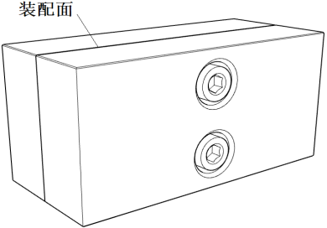
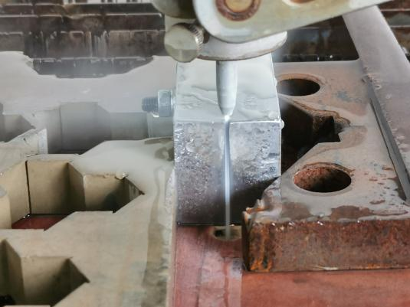
总体思路
本文的主要研究内容包括3个方面。首先，考虑现有研究的局限性，针对如何获取射流切缝形貌的问题，本文采用无损获得切缝的实验方法，并使用三维扫描仪采集切缝形貌。进一步的，利用Matlab和Rhinoceros软件，研究射流流形的三维模型问题。最后，在此基础上进行仿真切割，并实验验证仿真的有效性。

Slide 9
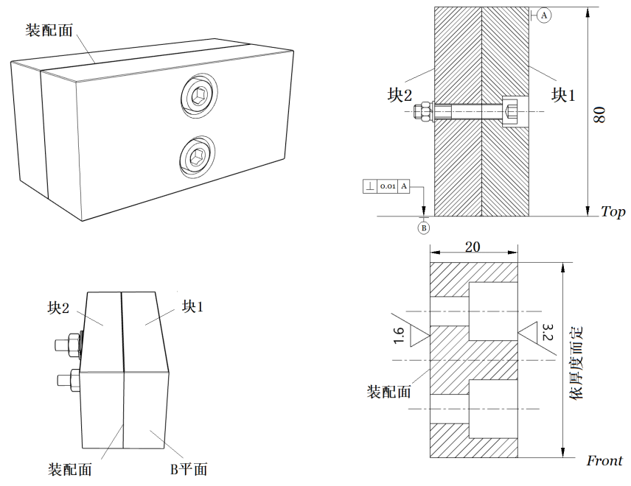
实验样件
可分离，装配面精加工，对称设计可进行两次切割实验

Slide 10
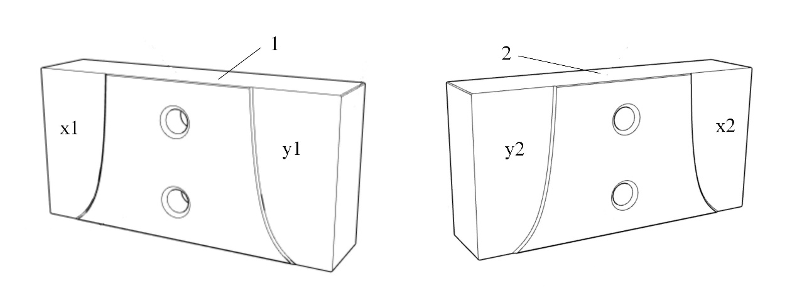
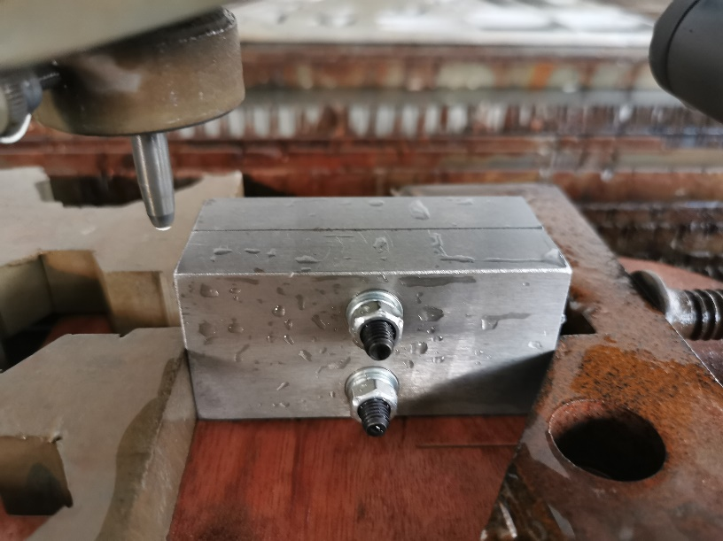
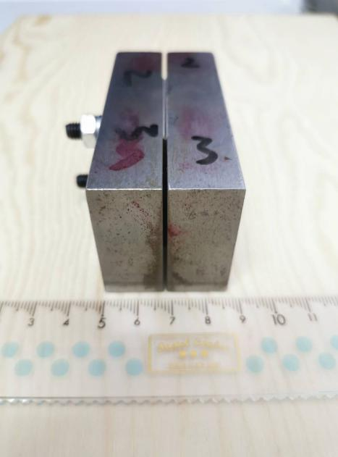
实验操作
2
1
装夹好的样件以及分离后的样件装夹的样件以及分离后的样件
3
4

Slide 11
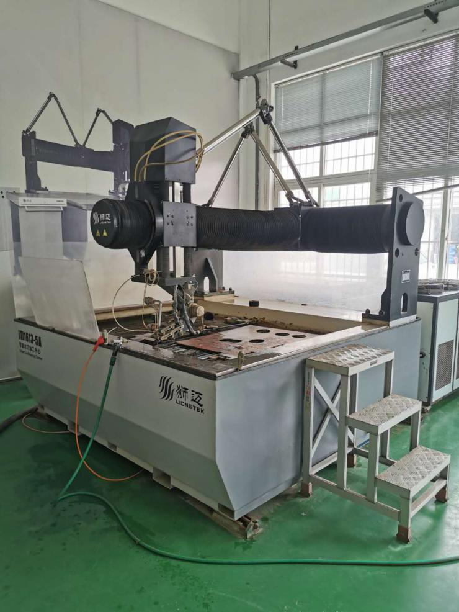
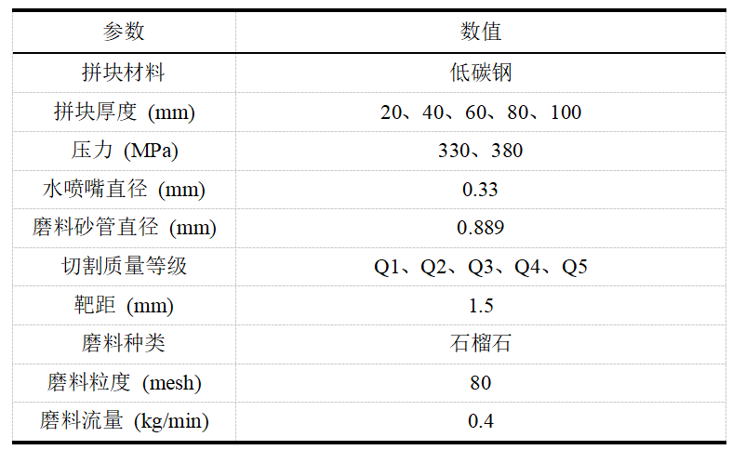
切割实验
实验平台LTJ1613-5A
该部分实验共计50组

Slide 12
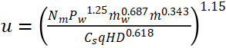
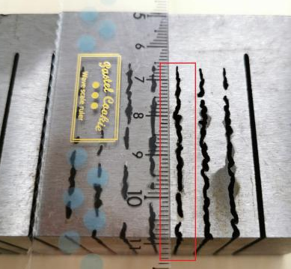
切割实验
等级越高，速度越慢。Q1级对应分离速度。需先进行分离速度的测定实验。下表面粘连长度不超过1.6 mm。
u是切割速度，q是切割质量等级，其他参数指具体工况条件（如压力、水流量等）。将常用的切割质量等级分为Q1~Q5级，分别对应不同的切割速度。

Slide 13
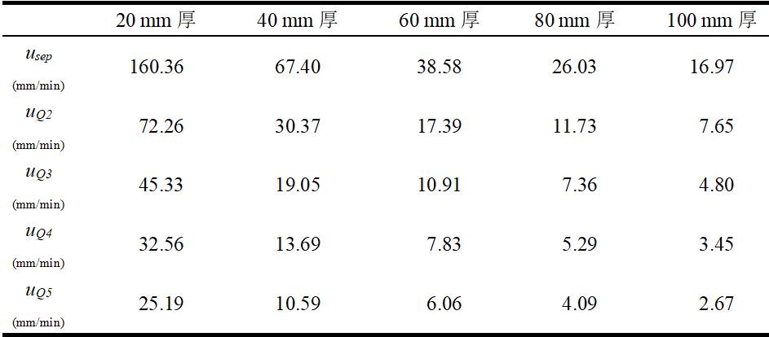
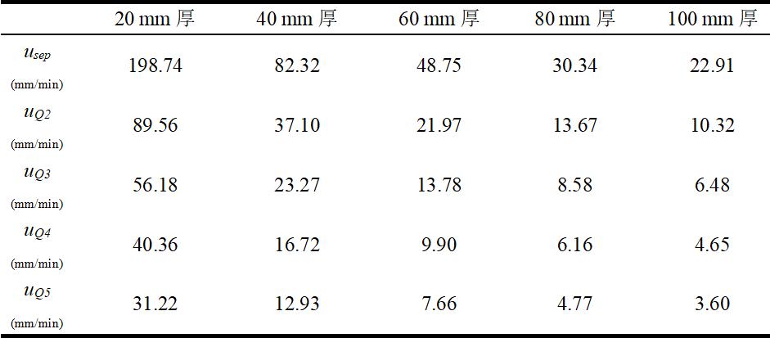
切割实验
330 MPa压力下的切割速度
380 MPa压力下的切割速度

Slide 14
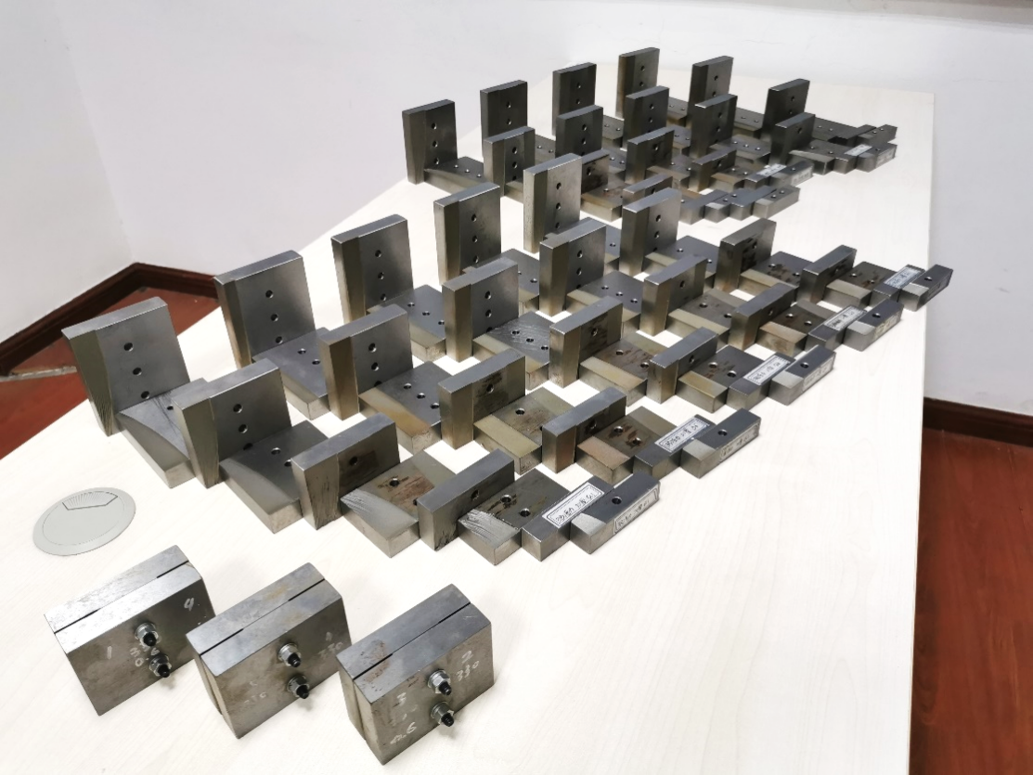
切割实验

Slide 15
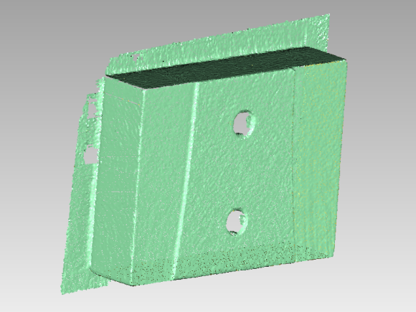
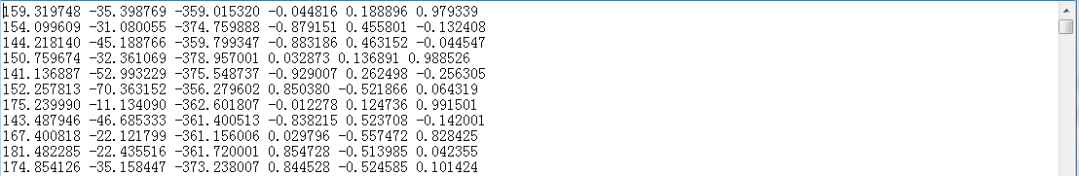
数据采集
激光扫描采集的数据是包括所有点的坐标的数组，索引0~5分别为X, Y, Z坐标，空间法向量
每行为一个子元素

Slide 16
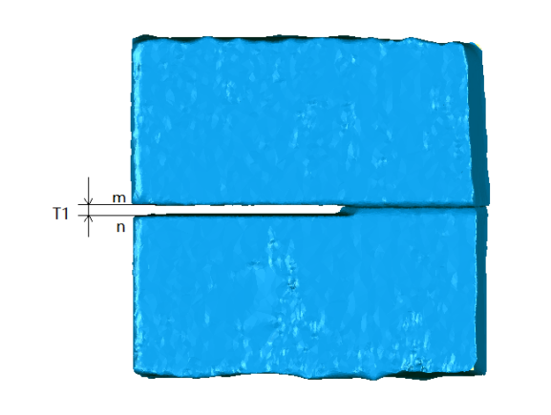
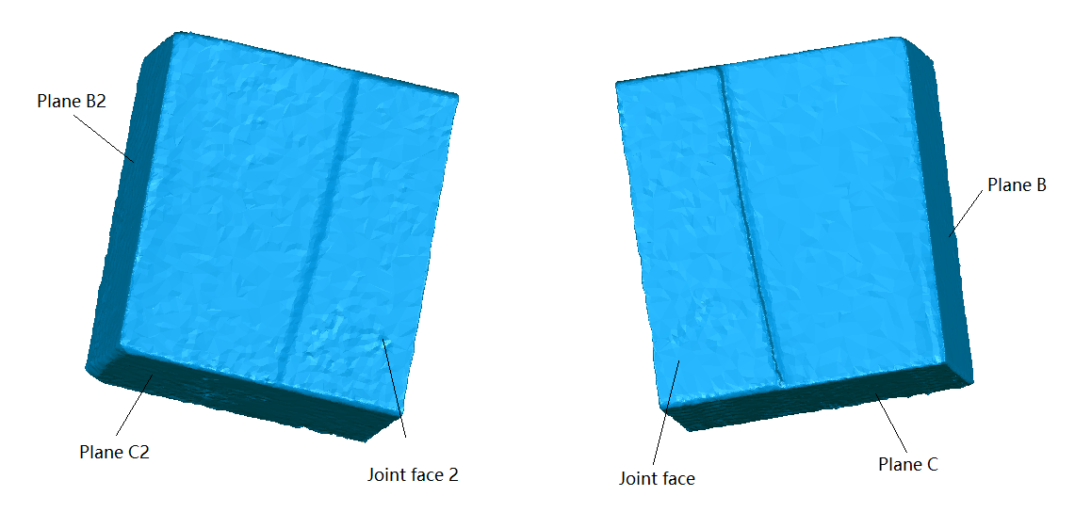
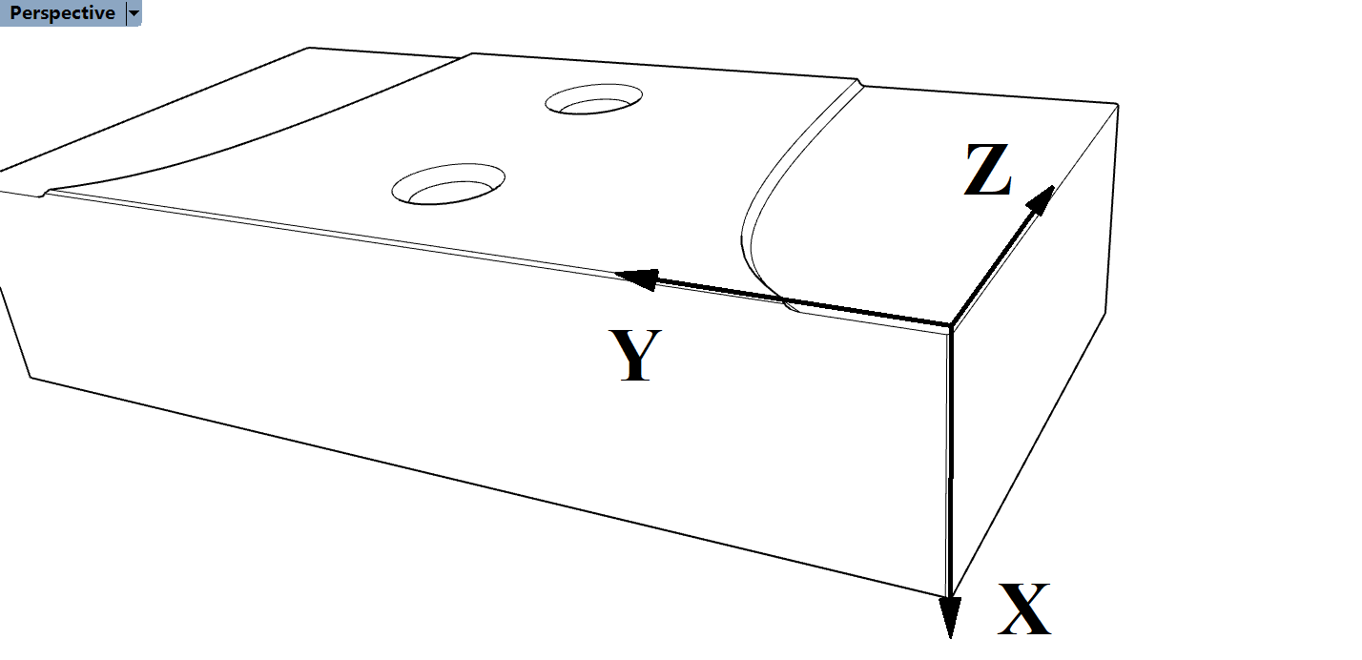
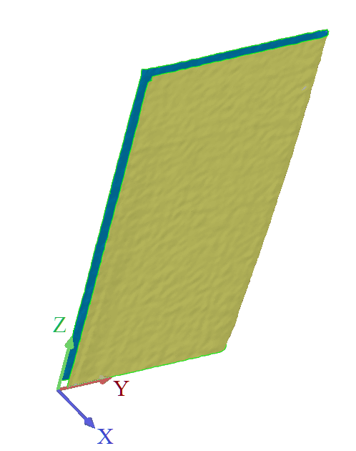
数据处理
2
1
3
4

Slide 17
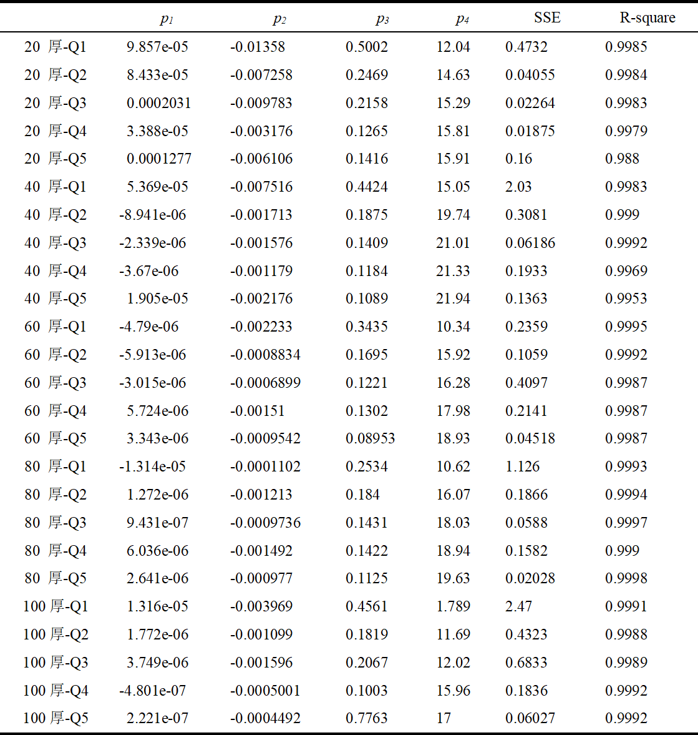
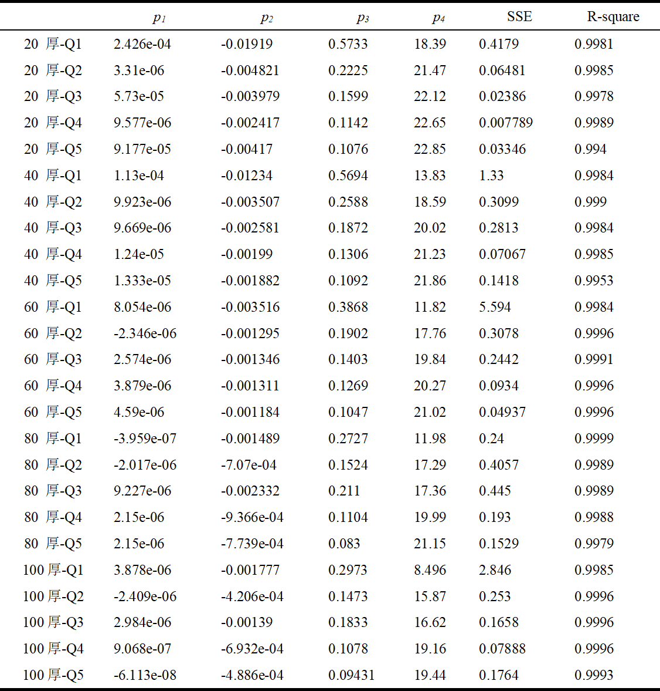
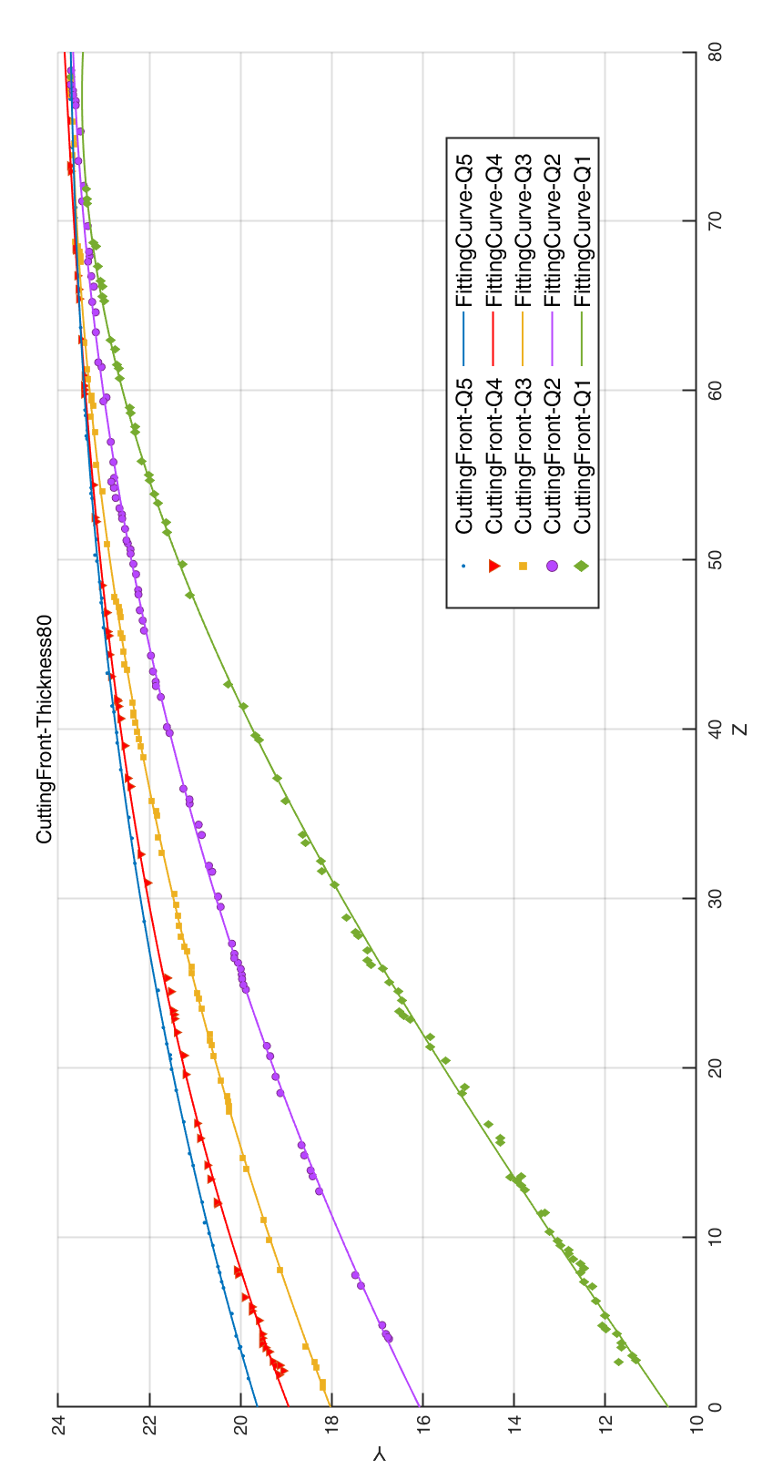
数据处理
拟合切割前沿曲线
330MPa
380MPa

Slide 18
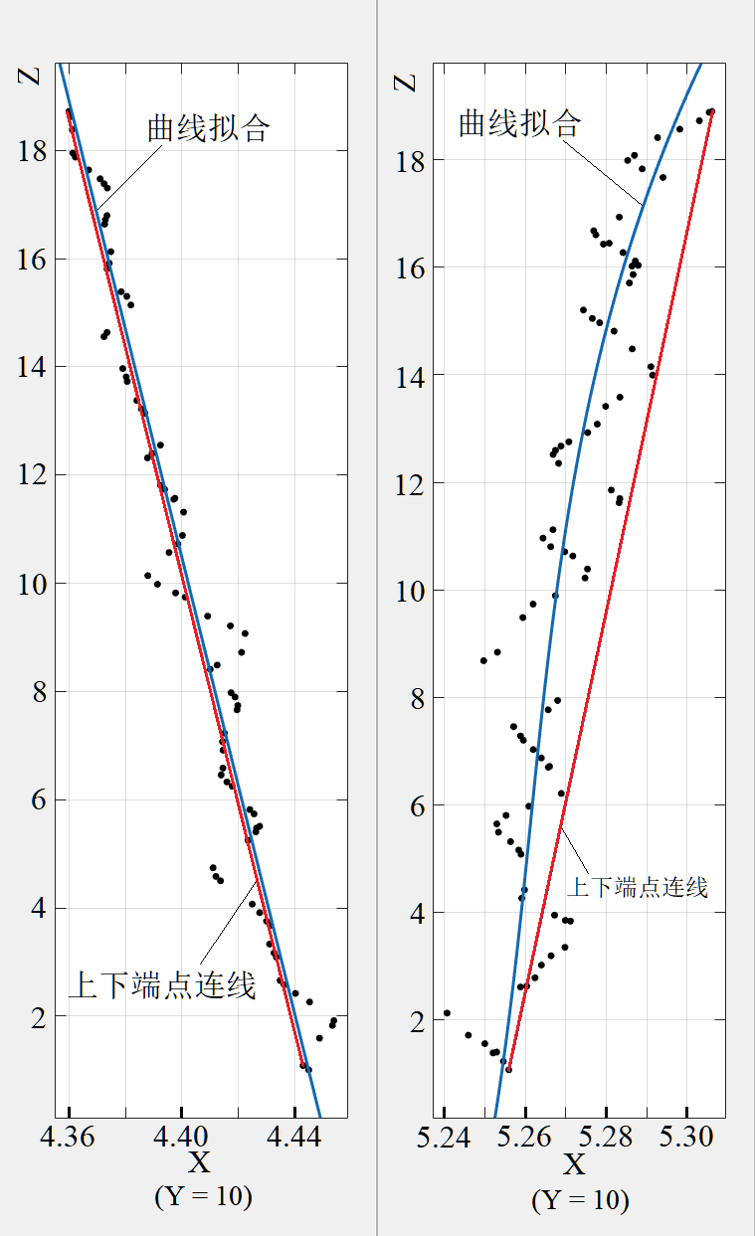
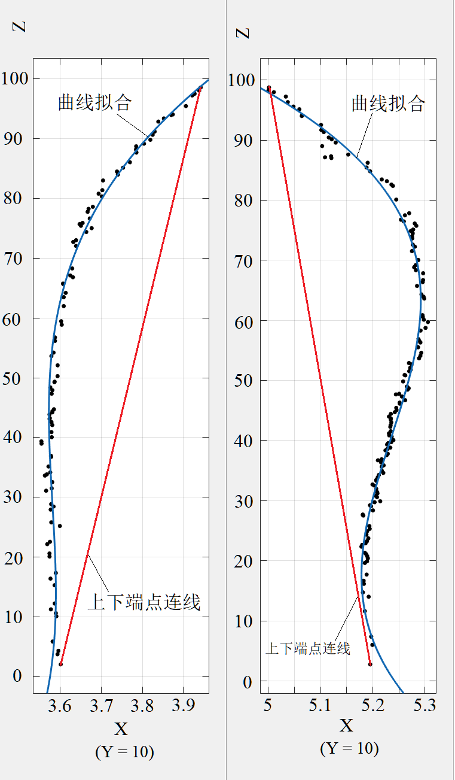
数据处理
330MPa,20mm Q5
330MPa,100mm Q5

Slide 19
数据处理
能量和，其值大小为动能密度与停留时间的乘积。要切开某一点的材料，当前点的能量和必须大于等于切开材料所需的能量阈值。
20 mm厚
100 mm厚

Slide 20
数据处理
在本文的切割条件下，低碳钢的厚度阈值约为69.7 mm。
厚度大于69.7 mm | 厚材料 | 切缝侧边轮廓为外凸型曲线
厚度低于69.7 mm | 薄材料 | 切缝侧边轮廓为可能是内凹曲线型 或直线型（由具体切割速度而定）

Slide 21
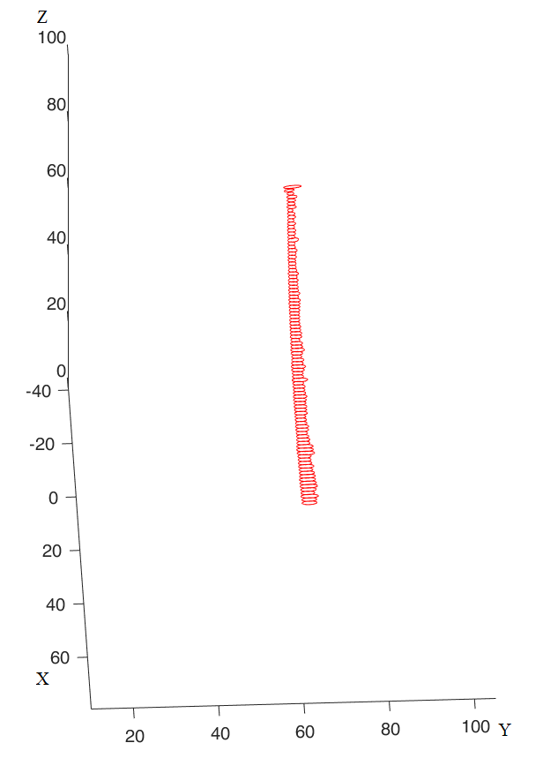
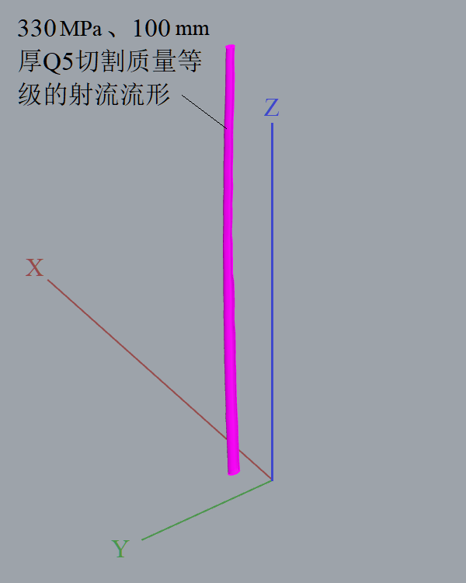
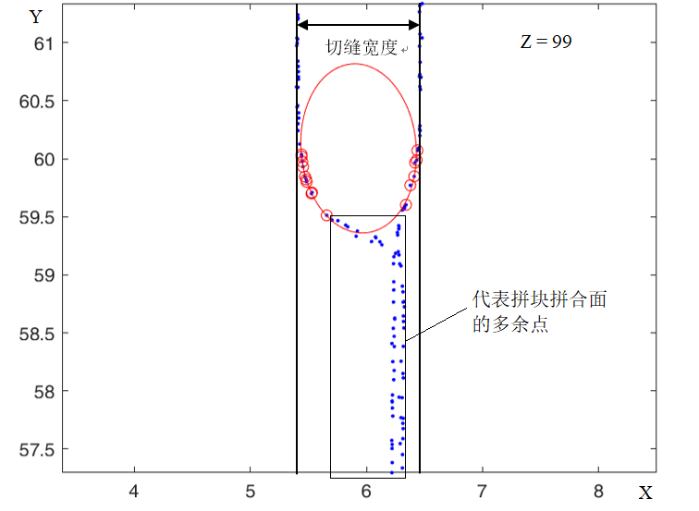
射流流形几何建模
2
3
1
切片、椭圆拟合
曲线放样
曲线堆叠

Slide 22
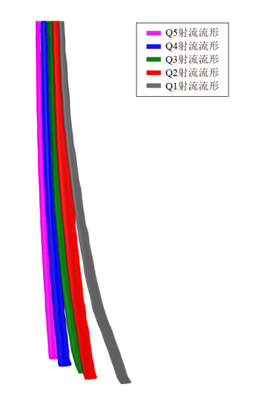
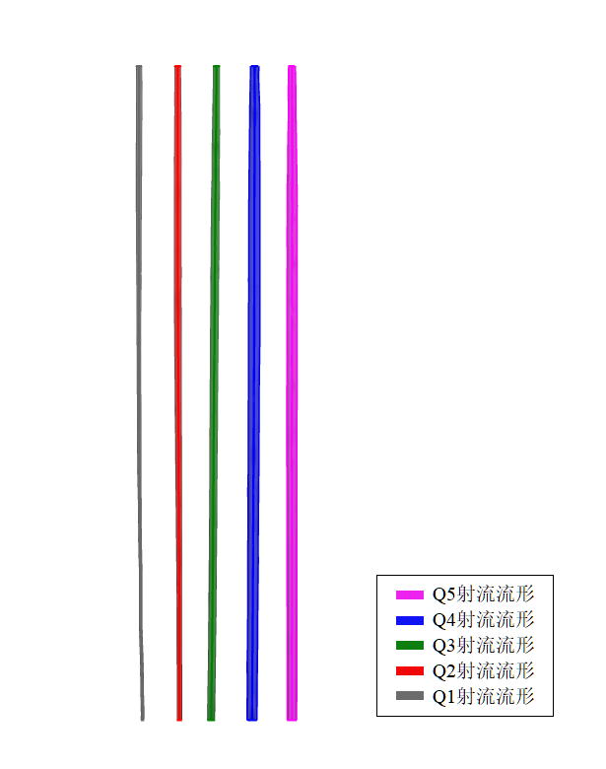
流形分析
切割速度对切割前沿的影响
切割速度对侧边轮廓的影响

Slide 23
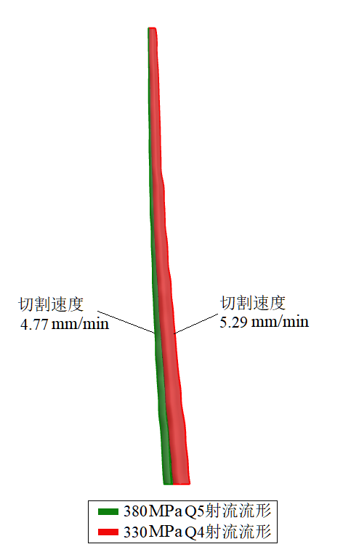
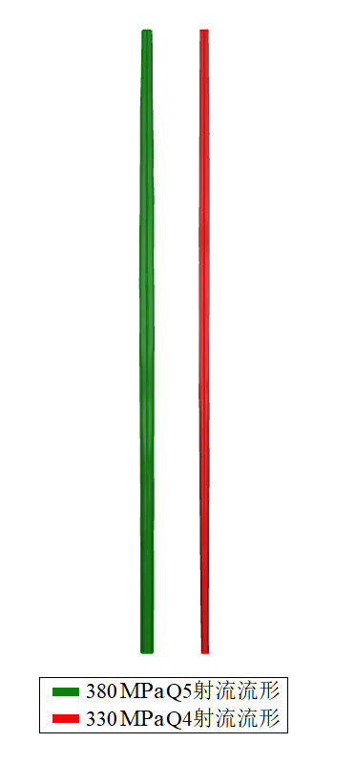
流形分析
压力对切割前沿的影响
压力对侧边轮廓的影响

Slide 24
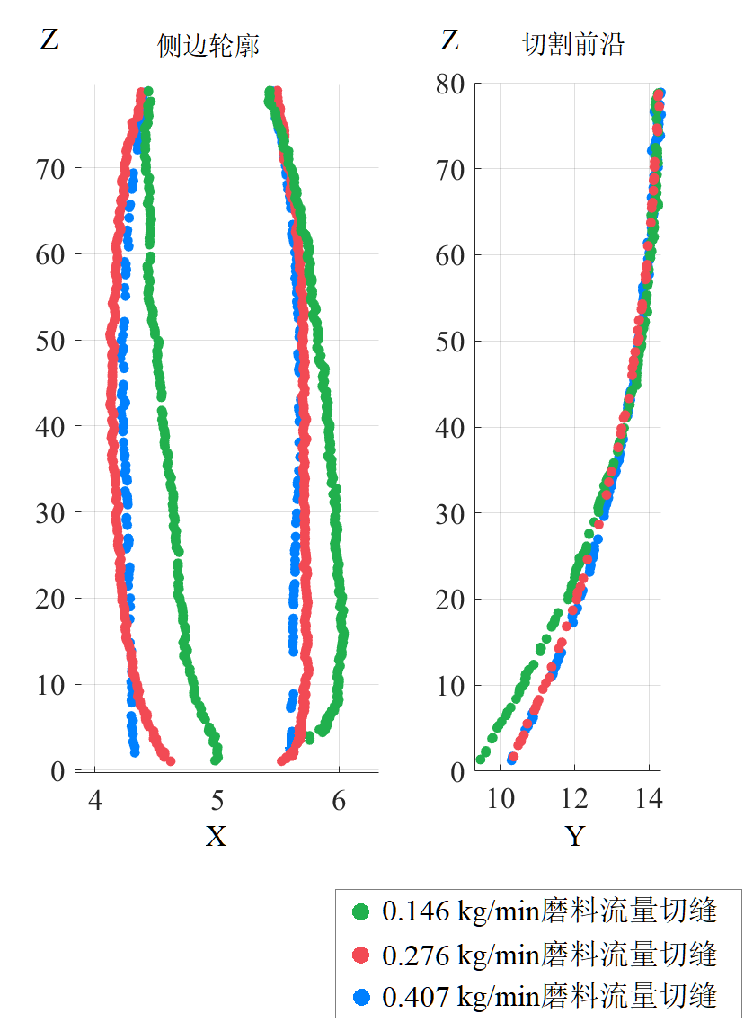
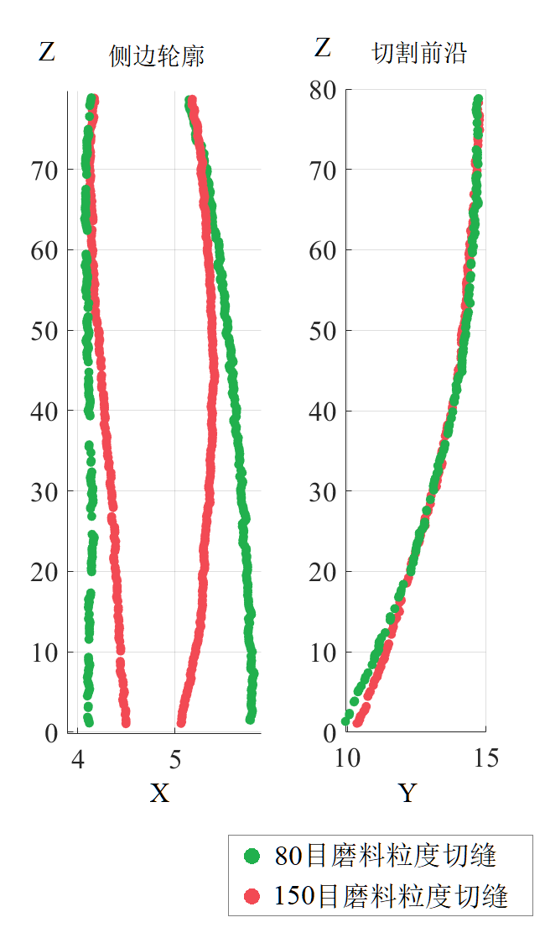
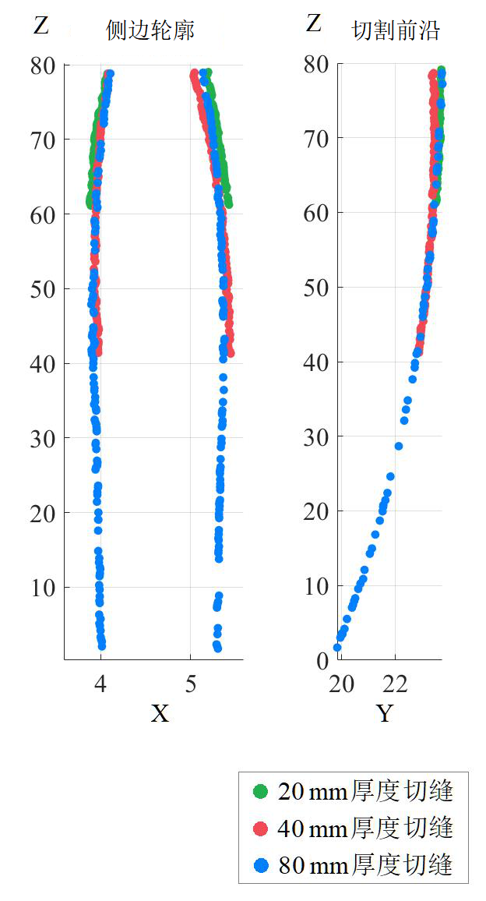
流形分析
厚度对切缝误差特征的影响
磨料流量对误差特征的影响
磨料粒度对误差特征的影响

Slide 25
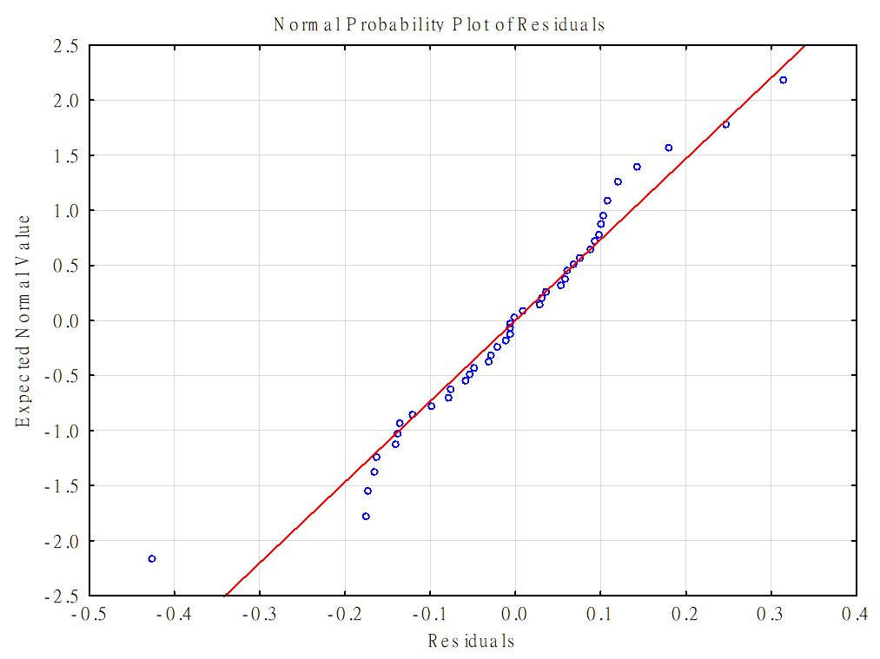
误差特征建模
后拖量特征建模
后拖量 J 与水压 P_{w} ，磨料流量 m，材料厚度 H，切割速度 u的数学模型
回归模型的判定系数
R-square = 0.96644761 > 0.95
后拖量回归模型的残差正态概率分布图

Slide 26
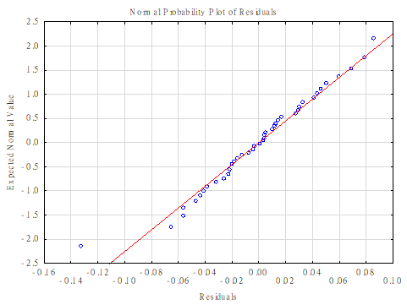
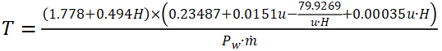
误差特征建模
切缝上下宽度差特征建模
切缝上下宽度差T 与水压 P_{w} ，磨料流量 m，材料厚度 H，切割速度 u的数学模型
回归模型的判定系数
R-square = 0. 97037035 > 0.95
上下切缝宽度差回归模型的残差正态概率分布图

Slide 27
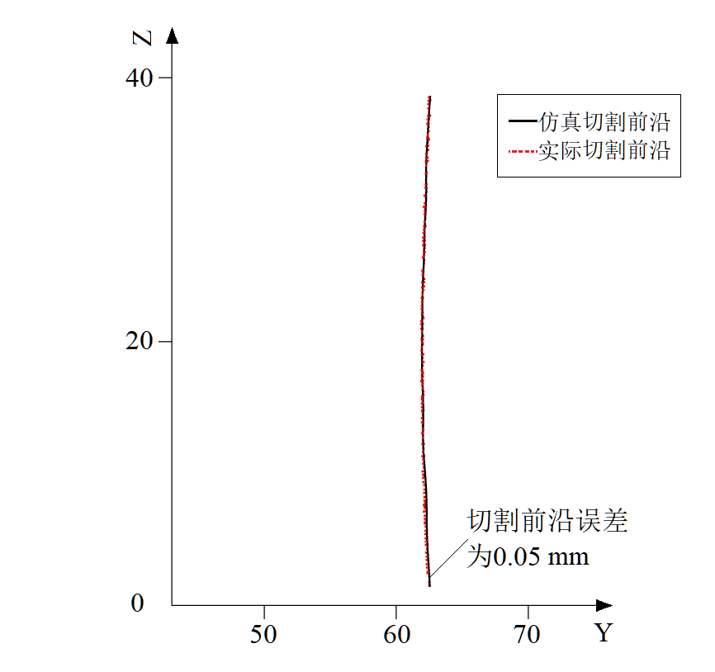
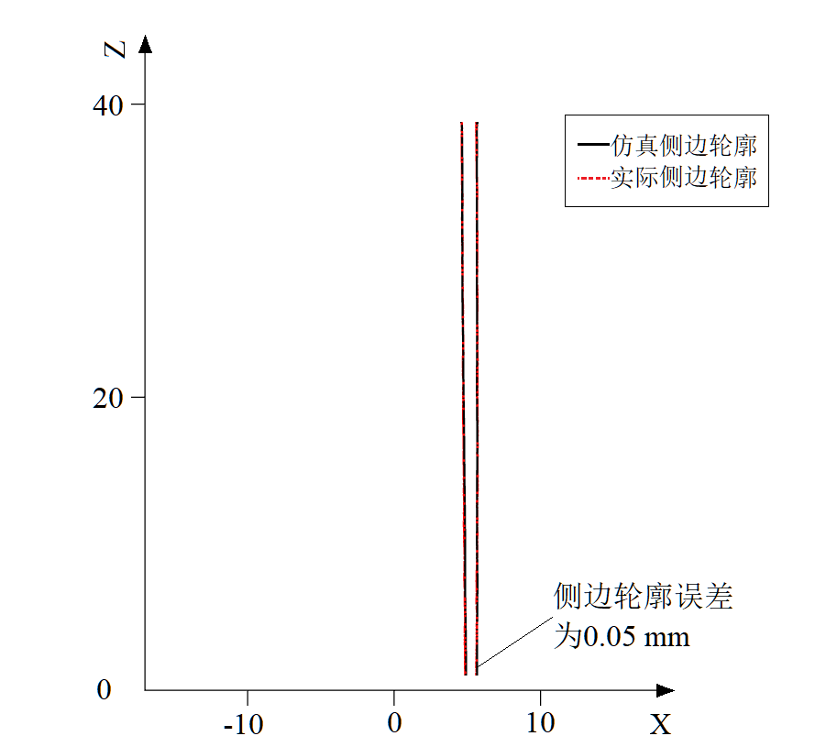
仿真加工及检验
330 MPa压力，40 mm厚度，Q3质量等级
2
3
1
仿真补偿切割(左)和实际补偿切割(右)
仿真与实际的切割前沿对比
仿真与实际的侧边轮廓对比

Slide 28
结论
03

Slide 29
结论
模型分析和仿真结果表明：
(1) 本文设计的切缝形貌采集方法可以实现磨料射流切缝形貌的精确3D表征；
(2) 材料厚度与切割速度是影响后拖量及上下切缝宽度最为重要的因素；
(3) 基于切缝形貌3D表征的补偿方法可以有效补偿切缝误差，进一步提高加工质量；

Slide 30
总结与展望
04

Slide 31
总结与展望
本文的研究在理论上拓展了对磨料射流加工过程及切缝形貌误差特征的研究视角，在实践上对提高磨料射流对金属的加工质量，提供了建议对策，为磨料射流加工厚金属材料提供了参考。

Slide 32
参考文献
[1]张海艳, 张连锋. 航空发动机整体叶盘制造技术国内外发展概述[J]. 航空制造技术, 2013, 443(z2): 38-41
[2]余武. 磨料水射流切割技术专利分析[J]. 科技创新与应用, 2019(35): 12-13
[3]Hashish, M., A Study on AWJ Trimming of Composite Aircraft Stringers [C]. ASME 2009 Pressure Vessels and Piping Conference, 2009
[4]张曙光. 基于倾角补偿的磨料水射流曲线切割技术研究[D]. 山东大学, 2010: 77-83
[5]Hashish, M., Current and Potential Robotic AWJS [DB/OL]. https://www.wjta.org/wjta/Robotic_AWJ_Systems.asp
[6]Hashish, M., Cutting and Shaping of Thick Materials with AWJ [DB/OL]. https://www.wjta.org/wjta/Thick_Cutting.asp
[7]涂运凤, 冯燕. 机器人七轴水射流整体叶盘切割装置[P]. ZL206764579U, 2017-12-19, 中国
[8]Xue, S., Chen, Z., Han, C., et al. Introduction and Analysis of the Ultrahigh Pressure Water Jet Cutting Multifuctional Application [C]. 2017 WJTA-IMCA Conference and Expo, October 25-27, 2017, New Orleans, Louisiana

Slide 33
参考文献
[9]Hashish, M., Waterjets for Aeroengine Applications [C]. The 24th International Conference on Water Jetting, 2018, pp. 207~217
[10]Bergs, T., Schüler, M., Arntz, K., et al. Technological Analysis of Different Abrasive Water Jet Machining Strategies for BLISK Roughing [C]. 2019 WJTA Conference and Expo, November 11-13, 2019, New Orleans, Louisiana
[11]高航, 袁业民, 陈建峰, 等. 航空发动机整体叶盘磨料水射流开坯加工技术研究进展[J]. 航空学报, 2020, 41(2): 6-27
[12]Chen, M., Zhang, S., Zeng, J., et al. Correcting Shape Error Located in Cut-in/cut-out Region in Abrasive Water Jet Cutting Process [J]. The International Journal of Advanced Manufacturing Technology, Vol. 102, No. 5-8, 2018, pp. 1165~1178
[13]王舒. 厚材料3D水射流精密切割切缝特性研究[D]. 重庆大学, 2017
[14]吴逾强. 高压磨料射流切缝特性实验研究[D]. 重庆大学, 2011

Slide 34
参考文献
[15]Hashish, M., Steele, D.E., Machining with Super-pressure (690 MPa) Waterjets [J]. International Journal of Machine Tools & Manufacture, Vol. 37, No. 4, 1997, pp. 465~479
[16]Susuzlu, T., Hoogstrate, A.M., Karpuschewski, B., Initial Research on the Ultra-high Pressure Waterjet up to 700 MPa [J]. Journal of Materials Processing Technology, Vol. 149, No. 1, 2004, pp. 30~36
[17]沈忠厚. 水射流理论与技术[M]. 石油大学出版社, 1998
[18]高端技术 遍布万家——访美国福禄公司首席执行官 CHARLESM BROWN 先生和亚洲区总裁 BRADHILLAM 先生[J]. 现代制造, 2009(33): 15-16
[19]孙家骏. 水射流切割技术[M]. 中国矿业大学出版社, 1992
[20]吴逾强. 超高压磨料水射流精密切割3D模型基础研究[D]. 重庆大学, 2015

Slide 35
参考文献
[21]Liu, H., Waterjet Technology for Machining Fine Features Pertaining to Micro-machining [J]. Journal of Manufacturing Processes, Vol. 21, No. 1, 2010, pp. 8~18
[22]Liu, H., Hovanski, Y., Caldwell, D.D., et al. Low-cost Manufacturing of Flow Channels with Multi-nozzle Abrasive-waterjets: A Feasibility Investigation [C]. Proceedings of the 19th International Conference on Water Jetting, October 15-17, 2008, Nottingham
[23]Liu, H., Schubert, E., Piercing in Delicate Materials with Abrasive-waterjets [J]. The International Journal of Advanced Manufacturing Technology, Vol. 42, No. 3, 2009, pp. 263~279
[24]周大鹏. 磨料水射流精密切割质量控制与补偿的研究[D]. 中国矿业大学, 2013
[25]Hashish, M., On the Modeling of Abrasive-waterjet Cutting [C]. Proceedings of the 7th International Symposium on Jet Cutting Technology, June 26-28, 1984, Ottawa, Canada

Slide 36
参考文献
[26]Matsui, S., Matsumura, H., Ikemoto, Y., et al. High Precision Cutting Method for Metallic Materials by Abrasive Waterjet [C]. Jet Cutting Technology-Proceedings of the 10th International Symposium, October 31-November 2, 1990, Amsterdam
[27]Kitamura, M., Ishikawa, M., Sudo, K., et al. Cutting of Steam Turbine Components Using An Abrasive Waterjet [C]. Jet Cutting Technology-Proceedings of the 11th International Symposium, September 8-10, 1992, St Andrews, Scotland
[28]Hashish, M., Benefits of Dynamic Waterjet Angle Compensation [C]. Proceedings of the 2007 American WJTA Conference and EXPO, August 19-21, 2007, Houston, Texas
[29]Henning, A., Westkämper, E., Schmidt, B., Analysis of Geometry at Abrasive Waterjet Cutting Operation [C]. Proceedings of the 17th International Conference on Water Jetting, September 7-9, 2004, Mainz, Germany
[30]Henning, A., Westkämper, E., Analysis of the Cutting Front in Abrasive Waterjet Cutting [C]. Proceedings of the 18th International Conference on Water Jetting, September, 2006, Gdansk, Poland

Slide 37
参考文献
[31]Henning, A., Westkämper, E., Dynamic Analysis of the Spatial-temporal Behaviour of the Cutting Front in Abrasive Waterjet Cutting [C]. Proceedings of the 2007 American WJTA Conference and EXPO, August 19-21, 2007, Houston, Texas
[32]Akkurt, A., Cut Front Geometry Characterization in Cutting Applications of Brass with Abrasive Water Jet [J]. Journal of Materials Engineering and Performance, Vol. 19, No. 4, 2010, pp. 599~606
[33]Zhang, S., Wu, Y., Wang, S., An Exploration of an Abrasive Water Jet Cutting Front Profile [J]. The International Journal of Advanced Manufacturing Technology, Vol. 80, No. 9, 2015, pp. 1685~1688
[34]Chung, Y., Geskin, E.S., Singh, P.J., Prediction of the Geometry of the Kerf Created in the Course of Abrasive Waterjet Machining of Ductile Materials [C]. Jet Cutting Technology-Proceedings of the 11th International Symposium, September 8-10, 1992, St Andrews, Scotland

Slide 38
参考文献
[35]Groppetti, R., Gutema, T., Di, Lucchio, A., A Contribution to the Analysis of Some Kerf Quality Attributes for Precision Abrasive Waterjet Cutting [C]. Proceedings of the 14th International Conference on Jetting Technology, September 21-23, 1998, Brugge, Belgium
[36]Annoni, M., Monno, M., A Lower Limit for the Feed Rate in AWJ Precision Machining [C]. Proceedings of the 15th International Conference on Jetting Technology, September 6-8, 2000, Ronneby, Sweden
[37]Hashish, M., Enhanced Abrasive Waterjet Cutting Accuracy with Dynamic Tilt Compensation [C]. CRIP 2nd International Conference on High Performance Cutting, , June 12-13, 2006, Vancouver, British Columbia, Canada
[38]Maccarini, G., Monno, M., Pellegrini, G., et al. Characterization of the AWJ Kerf: The Influence of Material Properties [C]. Proceedings of the 19th International Conference on Water Jetting, October 15-17, 2008, Nottingham

Slide 39
参考文献
[39]Shanmugam, D.K., Wang, J., Liu, H., Minimisation of Kerf Tapers in Abrasive Waterjet Machining of Alumina Ceramics Using a Compensation Technique [J]. International Journal of Machine Tools and Manufacture, Vol. 48, No. 14, 2008, pp. 1527~1534
[40]Hlaváč, L., Hlaváčová, I., Geryk, V., et al. Investigation of the Taper of Kerfs Cut in Steels by AWJ [J]. The International Journal of Advanced Manufacturing Technology, Vol. 77, No. 9-12, 2015, pp. 1811~1818
[41]Hlaváč, L., Hlaváčová, I., Geryk, V., Taper of Kerfs Made in Rocks by Abrasive Water Jet (AWJ) [J]. The International Journal of Advanced Manufacturing Technology, Vol. 88, No. 1-4, 2017, pp. 443~449
[42]Pahuja, R., Ramulu, M., Abrasive Water Jet Machining of Titanium (Ti6Al4V)–CFRP Stacks – A Semi-analytical Modeling Approach in the Prediction of Kerf Geometry [J]. Journal of Manufacturing Processes, Vol. 39, 2019, pp. 327~337
[43]陈冰海. 磨料射流无损精密切割机制研究[D]. 上海大学, 2019

Slide 40
参考文献
[44]Flow公司介绍[DB/OL]. https://www.flowwaterjet.com/
[45]Olsen, J., Zeng, J., Guglielmetti, B., Advanced Error Correction Methodology Applied to Abrasive Waterjet Cutting [C]. 2003 WJTA American Waterjet Conference, August 17-19, 2003, Houston, Texas
[46]狮迈科技有限公司介绍[DB/OL]. https://www.lionstek.com/
[47]南京大地水刀股份有限公司介绍[DB/OL]. https://www.dardi.cn/
[48]Hashish, M., Precision Cutting of Thick Materials with AWJ [C]. Proceedings of the 17th International Conference on Water Jetting, September 7-9, 2004, Mainz, Germany
[49]衣正尧, 武剑, 刘富强, 等. 纯水射流除锈性能的仿真对比分析与试验研究[J]. 流体机械, 2012, 40(06): 5-9
[50]薛胜雄. 高压水射流技术工程[M]. 合肥: 合肥工业大学出版社, 2006: 29-32

Slide 41
参考文献
[51]于超. 高压水射流结构与磨料分布特性的研究[D]. 燕山大学, 2012
[52]Crowe, C.T., Sommerfield, M., Tsuji, Y., Multiphase Flows with Droplets and Particles. CRC Press, Boca Raton, 1998, pp. 5~22
[53]Wang, R., Wang, M., A Two-fluid Model of Abrasive Waterjet. Journal of Materials Processing Technology, 2010, pp. 190~196
[54]Zhang, S., Wu, Y., Wang, Y., An Investigation of Surface Quality Cut by Abrasive Water Jet [J]. The Open Mechanical Engineering Journal, Vol. 5, No. 1, 2011, pp. 166~177
[55]Capello, E., Groppetti, R., On a Simplified Model for Hydro Abrasive Jet Machining Prediction, Control and Optimization [C]. Proceedings of the 7th American Water Jet Conference, 1993, Seattle, pp. 157~174
[56]柯熠, 毛桂庭, 欧阳邓培, 等. 后混式高压磨料水射流磨料分布规律分析[J]. 矿冶工程, 2017, 37(05): 30-34

Slide 42
参考文献
[57]章文峰, 卢义玉, 汤积仁, 等. 基于PIV技术的磨料水射流中固体磨料粒子速度分布实验研究[J]. 振动与冲击, 2016, 35(08): 159-165+186
[58]陈明. 基于极端切割条件的磨料水射流去误差机制[D]. 上海大学, 2019
[59]王志敏, 武美萍, 魏晶晶. 磨料水射流对脆性材料的冲蚀研究[J]. 工程设计学报, 2019, 26(01): 79-86
[60]Wu, Y., Zhang, S., Wang, S., et al. Method of Obtaining Accurate Jet Lag Information in Abrasive Water-jet Machining Process [J]. International Journal of Advanced Manufacturing Technology, Vol. 76, No. 9-12, 2015,pp. 1827~1835
[61]傅燕鸣. 机械设计课程设计手册[M], 上海科学技术出版社, 2013
[62]Zeng, J., Determination of Machinability and Abrasive Cutting Properties in AWJ Cutting [C]. 2007 American WJTA Conference and Expo, August 19-21, 2007, Houston, Texas

Slide 43
参考文献
[63]Chen, M., Zhang, S., Zeng, J., Exploring the Effectiveness of a Self-defined Virtual Cutting Method with a “Soft Knife” [J]. The International Journal of Advanced Manufacturing Technology, Vol. 106, 2020, pp. 3007~3015

Slide 44
感谢聆听 Thanks for listening
汇报人：姬李丹阳
回报日期：2021年5月8日

